Slide 1

Design of Wireless Black Box for Cars
Syrian Private University faculty of Artificial Intelligence Engineering Telecommunication Engineering
Prepared By:
MHD.Lutfe kassar
Supervised by:
D.Hassan ahmad
ENG.Mohamed othman
2026/31/5

Slide 2
Outline
Project Objective
Problem Statement & project Importance
Methodology
Reference studies
Theoretical Fundamentals
hardware implementation
Reference LIST

Slide 3
Project Objective
Design of Wireless Black Box for Cars

Slide 4
Problem Statement & project Importance
Problem Statement:
Traditional systems do not provide complete accident data.
Lack of continuous vehicle monitoring.
project Importance:
Track vehicle location.
Reduction of Insurance Fraud and Costs
Record real-time vehicle data.

Slide 5
Methodology
System Design and Requirement Analysis :
Study of the Project Objectives
Analysis of the Addressed Problems
Specification of System Functional Requirement
Selection of Appropriate Components
Hardware Selection and Setup:
Choose a microcontroller such as
ESP32
Integrate hardware components:
GPS module (for location tracking)
Mpu6050 (for speed and axis)
GSM or Wi-Fi module (for communication)
Sensors (vibration, speed, alcohol, temperature)
Connect components on a circuit board

Slide 6
Data Acquisition and Storage
Continuously collect data from sensors
Store data in:
SD Card or in cloud
Maintain logs with:
Time, location, speed, and sensor readings
Wireless Communication System
Send data using:
GSM (SMS alerts) or Wi-Fi/IoT
Transmit:
Location (GPS coordinates)
Optionally upload data to cloud server

Slide 7
Testing and Validation
Test system under different conditions:
Normal driving
Simulated accidents
Verify:
Accuracy of sensors
Reliability of data transmission

Slide 8
Reference studies

Slide 9
Paper reference | principle | Methodology
[1] Lakshmi, M., Aishwarya,(2024) | concept of integrating multiple sensors with a wireless communication system to continuously monitor vehicle parameters | hardware architecture and software development. In the hardware phase, sensors including temperature (LM35), vibration sensor, alcohol sensor (MQ-3), and accelerometer(MPU6050) are integrated with a microcontroller (Arduino). GPS and GSM modules are used for location tracking and communication
[2] Rajput, S., & Sharma, V. (2022) | real-time vehicle tracking and data recording using wireless communication technologies | The system integrates GPS for location tracking and GSM for sending SMS alerts. Sensor data is collected through a microcontroller and transmitted to predefined users for monitoring purposes.
[3] Kumar, A., & Singh, P. (2021). | IoT architecture to enable real-time monitoring and remote access to vehicle data through wireless networks | ESP32 microcontroller is used to collect sensor data and transmit it via Wi-Fi to a cloud platform. The system supports real-time visualization and remote monitoring

Slide 10
Paper reference | principle | Methodology
Omar, A., et al. (2024) | Based Smart Vehicle Accident Detection and Tracking System Using GPS and GSM Technologies. | microcontroller to trigger the SIM808 module upon an event. The GNSS receiver obtains latitude and longitude, and the GSM unit sends the location via SMS
Hanwei Electronics) 2018( | The MQ-3 sensor is based on semiconductor gas sensing | The sensor continuously measures alcohol concentration in the air. The microcontroller reads the analog value, compares it with a threshold, and triggers an alert if the limit is exceeded, often activating a communication module for notification

Slide 11
Theoretical Fundamentals
Communication Between Components
The system relies on standard communication protocols to enable data exchange between sensors, modules, and the microcontroller
I2C Protocol
Used for communication with sensors like the MPU (accelerometer & gyroscope) and RTC.
Two-wire interface: SDA (DATA) AND SCL (clock)
synchronous
Multiple devices are allowed on the same line
Half-duplex communication
Data transfer rates typically up to 400 kbit/s
I2C= Inter-Integrated Circuit

Slide 12
analog Interface:
Continuous voltage signal proportional to physical quantity
Requires Analog-to-Digital Conversion (ADC)
Used for sensors such as:
Alcohol sensor
Temperature sensor
Digital Interface:
Discrete binary output (HIGH/LOW)
Directly interpreted by microcontroller GPIO pins
Used for:
Vibration sensors (threshold-based output)

Slide 13
Data Storage Architecture
🔹 Local Storage (SD Card):
Stores structured logs (CSV or binary format)
Includes timestamped sensor readings
Ensures data persistence during network failure
🔹 Microcontroller Memory:
Temporary buffer for real-time processing
Limited capacity (RAM/Flash constraints)
🔹 Cloud Storage (Optional IoT Layer):
Remote database storage
Enables long-term analytics and accessibility
CSV=Comma-Separated Values
IOT= internet of things

Slide 14
UART Protocol
UART is a widely used asynchronous serial communication protocol that enables point-to-point data exchange.
Asynchronous (no shared clock signal)
Uses TX (Transmit) and RX (Receive) lines
Configurable baud rate
Simple frame structure (start bit, data bits, stop bit)
For wide range of embedded communication modules.
UART=Universal Asynchronous Receiver/Transmitter

Slide 15
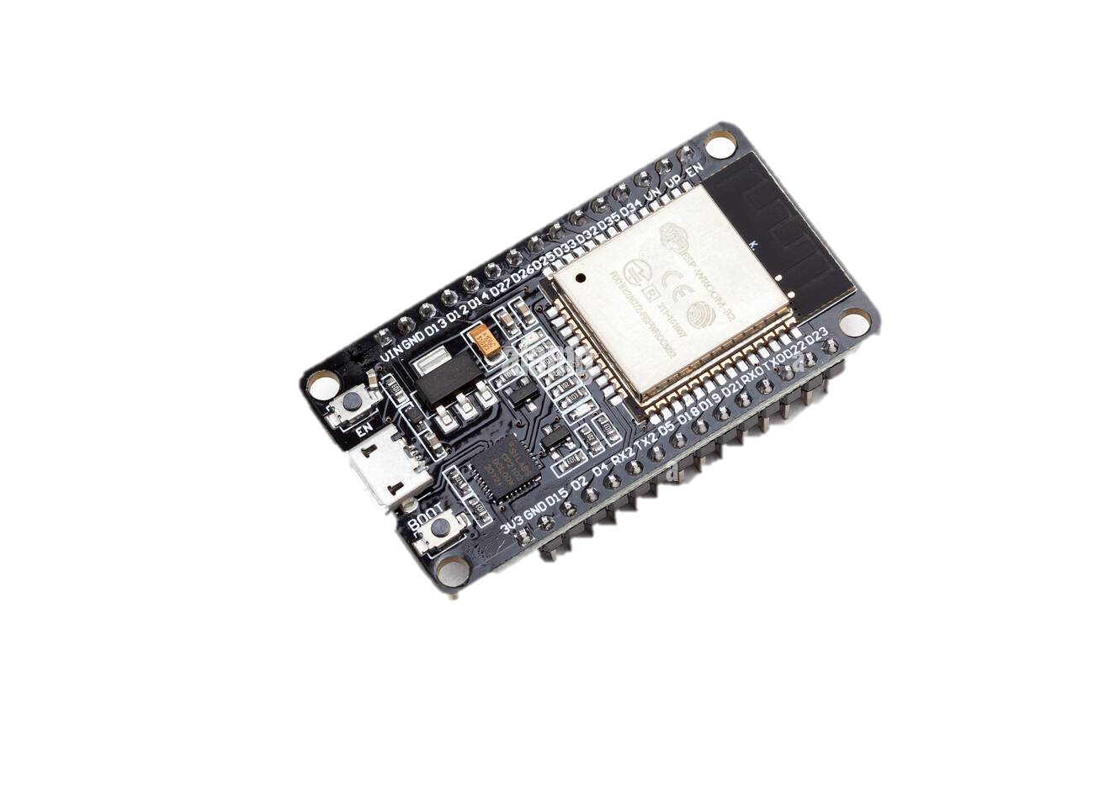
hardware implementation
ESP32 Microcontroller
The ESP32 acts as the MasterMind which responsible for:
Collecting sensor data
Running decision-making algorithms
Triggering alerts and communication modules
Synchronizing all subsystems
ESP32 is chosen due to:
High computational capability for real-time processing
Built-in wireless communication (reduces external modules)
Multi-channel ADC support for analog sensors
Low power consumption compared to similar MCUs

Slide 16
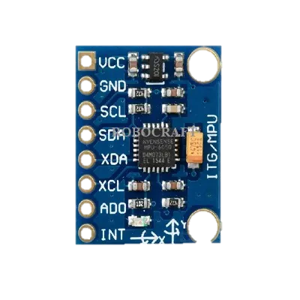
hardware implementation
MPU6050
Sensor type: 6-axis IMU (3-axis accelerometer + 3-axis gyroscope)
Detects acceleration, vibration, and orientation changes
Provides angular velocity and tilt estimation
Identifies abnormal motion patterns
MPU6050 enables inertial sensing, which is essential for:
Vehicle stability monitoring
Motion classification algorithm
MPU6050: Motion Processing Unit

Slide 17
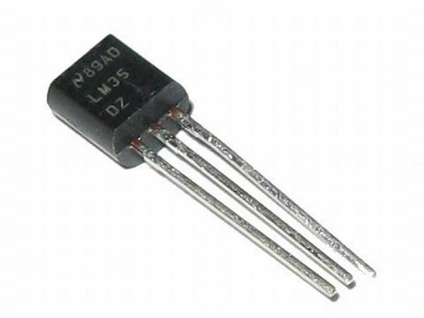
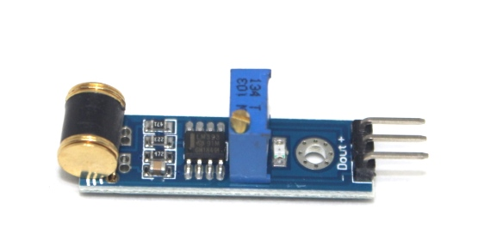
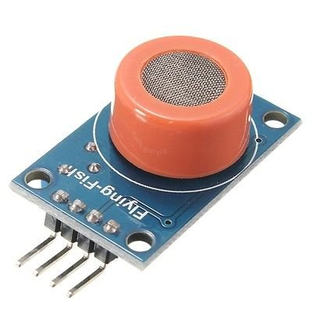
Temperature Sensor
LM35 Specifications:
Analog output sensor
Range: -55°C to +150°C
Accuracy: ±0.5°C
Vibration Sensor
Detects mechanical vibration and shocks
Acts as a trigger for sudden impact detection
Digital output signal
Adjustable sensitivity
Alcohol Sensor (MQ-3)
Measures alcohol concentration in breath/environment
Provides safety validation
Target gas: Ethanol

Slide 18
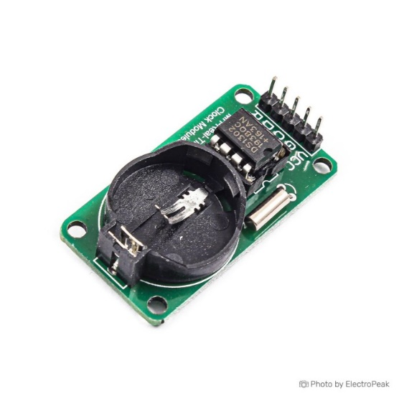
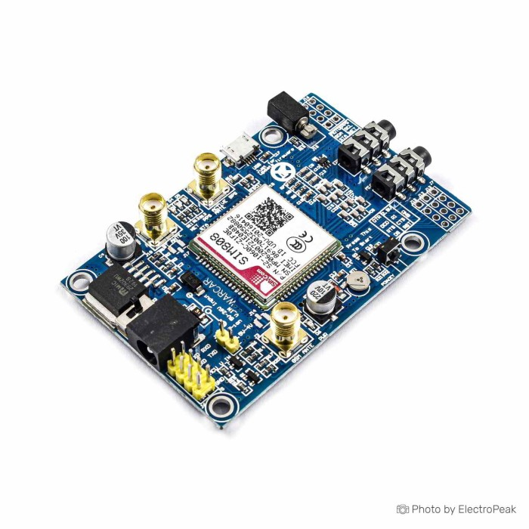
RTC(DS3231)
Maintains accurate time even during power loss
Critical for:
Event logging
Synchronization of system alerts
SIM808 Module
highly integrated communication module that combines:
GSM/GPRS communication
GPS positioning (GNSS receiver)
consists of two main subsystems
GSM/GPRS Subsystem
Handles:
SMS transmission
Voice calls
RTC=REAL TIME CLOCK

Slide 19
. Interface with ESP32
Uses UART (Serial Communication)
Typical Connection:
SIM808 TX → ESP32 RX
SIM808 RX → ESP32 TX
GND → GND
VCC → External 4V supply

Slide 20
Specification | Feature
GSM/GPRS + GPS integrated module | Module Type
Quad-band (850 / 900 / 1800 / 1900 MHz) | Cellular Bands
22 tracking / 66 acquisition channels | GPS Channels
~2.5 meters | GPS Accuracy
Tracking: -165 dBm | Sensitivity
UART (Serial) | Communication Interface
3.4V – 4.4V (typical 4V) | Operating Voltage
~2A peak (during transmission) | Current Consumption
TCP/IP, HTTP, SMS | Protocols Supported
External GSM + GPS antennas | Antenna Support

Slide 21
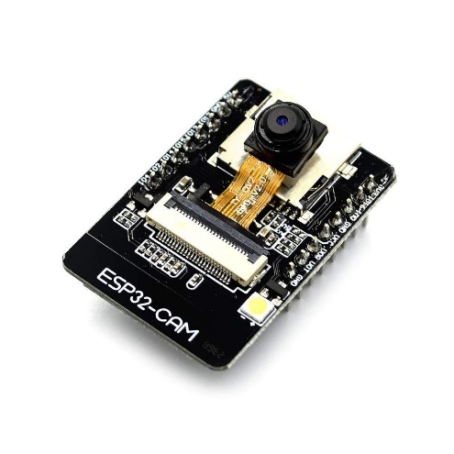
ESP32 CAM
The ESP32-CAM module is a compact microcontroller-based camera module that integrates:
OV2640 camera
WiFi connectivity
Optional microSD storage
high-performance microcontroller based on a 32-bit dual-core Xtensa LX6 architecture.
operates at a clock frequency of up to 240 MHz
equipped with approximately 520 KB of SRAM and typically includes around 4 MB of external flash memory
Camera Sensor (OV2640)
2MP resolution
Supports JPEG compression (important for IoT)
Low power consumption
Adjustable:
Brightness
Contrast
White balance

Slide 23
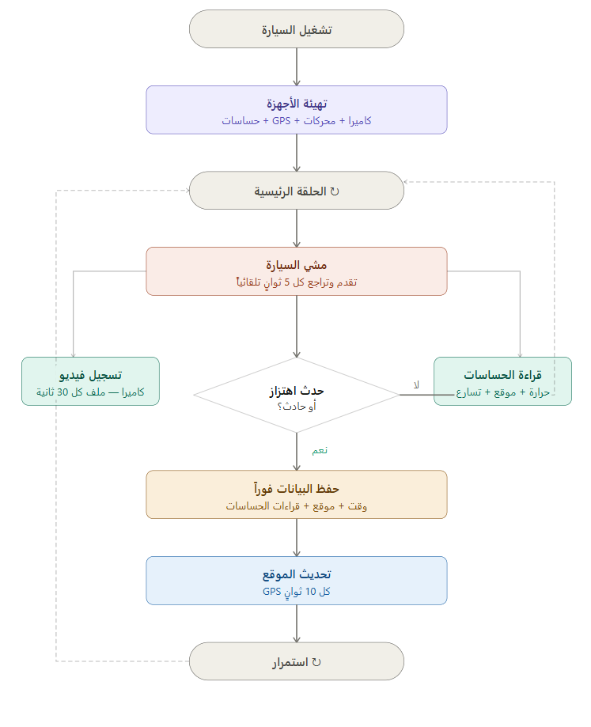
System flowchart:

Slide 24
Experimental Results
Assembly and integration of ESP32, MPU6050, LM35, MQ-3, vibration sensor, and SIM808.
Development of embedded software using Arduino IDE
Real-time acquisition and processing of sensor data.
Accident detection based on acceleration and vibration thresholds.
GPS location acquisition using SIM808.
Data logging and system performance testing under different scenarios

Slide 25
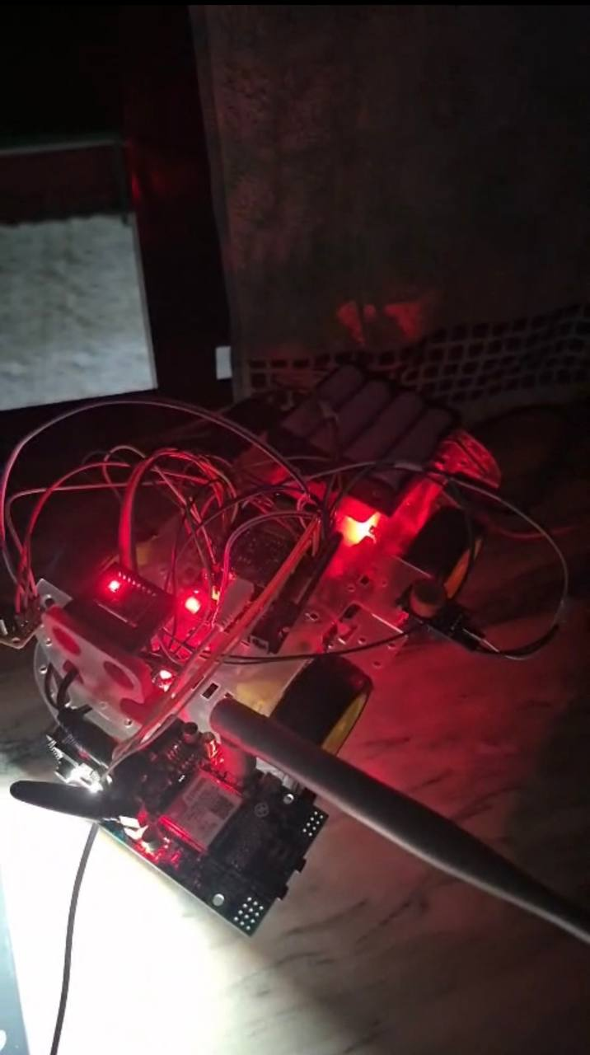
Photo of project:

Slide 26
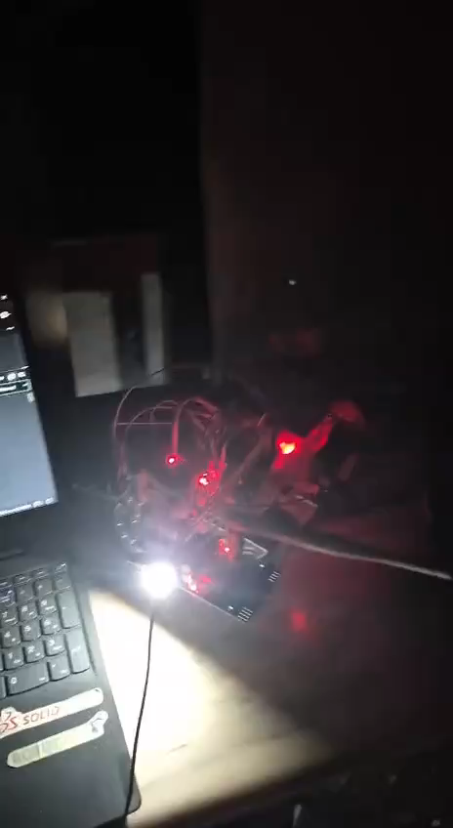
Demo video

Slide 27
Telemetry massage :
REC=s,RTC=2026-05-30 21:18:42,MOTOR=FORWARD,PWM=180,MQ3_RAW=1420,MQ3_V=1.144,VIB=0,VIB_EVENT=0,LM35_1=24.8,LM35_2=25.1,LM35_3=24.6,LM35_4=26.0,AX=0.012,AY=-0.034,AZ=0.987,MPU_MOVE=STABLE,GPS_FIX=1,LAT=33.513805,LON=36.276527,ALT=690.5,GPS_SPEED=0.12

Slide 28
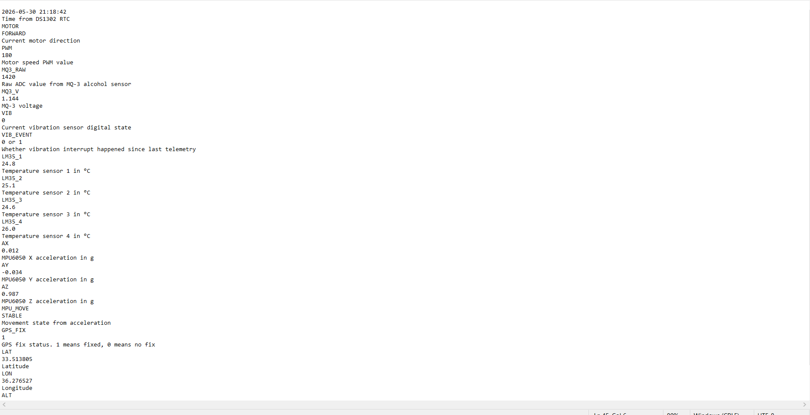

Slide 29
Reference LIST
[1] Lakshmi, M., & Aishwarya, S. (2024). Smart vehicle monitoring and accident detection system using IoT.
[2] Rajput, S., & Sharma, V. (2022). IoT-based vehicle tracking and safety system using GSM and GPS technologies
[3]Hanwei Electronics. (2018). MQ-3 Alcohol Sensor Datasheet. Retrieved from http://www.hwsensor.com
[4] SIMCom Wireless Solutions. (2016). SIM808 Hardware Design Document. Retrieved from https://simcom.ee
[5] [3] Kumar, A., & Singh, P. (2021). ESP32 microcontroller is used to collect sensor data and transmit it via Wi-Fi

